Slide 1
A PRIVACY-PRESERVING EDGE TINYML SYSTEM FOR ACOUSTIC COMFORT ESTIMATION USING HYBRID DSP-CNN FUSION AND VISUAL FEEDBACK
Team Members:
Plan Ghimire(THA080BEI028)
Pranjal Shrestha(THA080BEI033)
Sagun Acharya(THA080BEI037)
Samman Ghale(THA080BEI039)
Supervised by:
Er. Binod Sapkota
Department of Electronics and Computer Engineering
Institute of Engineering, Thapathali Campus
July 2026
1

Slide 2
Presentation Outline
1
Motivation
2
Objectives
3
Scope & Context
4
Literature Review
5
Applications
6
Methodology
7
Results
8
Analysis
9
Future
Enhancements
10
Conclusion &
References
July 2026
2

Slide 3
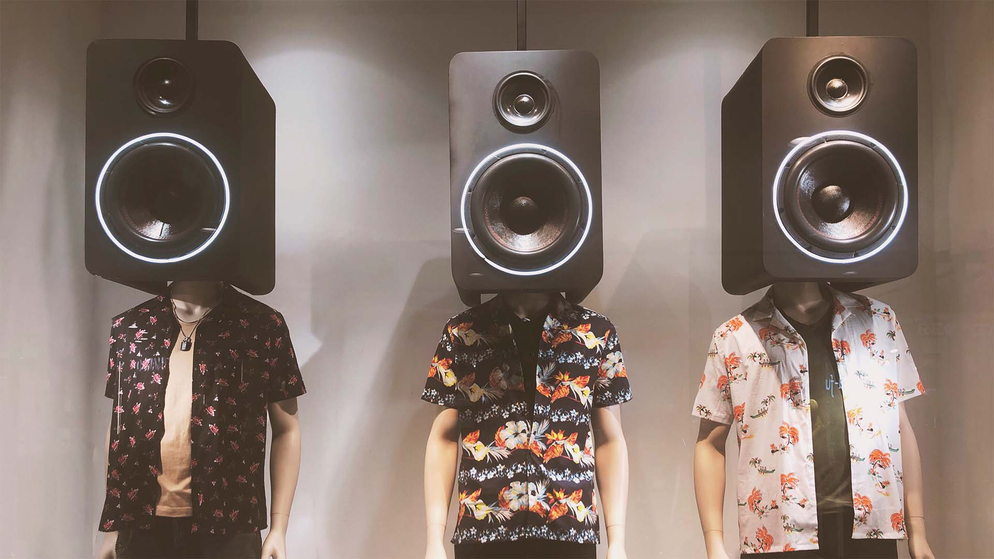
Motivation
Noise directly affects concentration and productivity.
Shared spaces can amplify disturbances through irrelevant speech, the Lombard effect, and the café effect.
Why acoustic comfort matters
Shared rooms become noisy quickly.
People often raise their voices unconsciously.
Numerical meters demand continuous attention.
Buzzers can add further disturbance.
Visual feedback enables self-regulation.
Figure: Lombard effect. Image source: Audiocare.
July 2026
3

Slide 4
Objectives
Main Objective
Develop an intelligent acoustic-awareness system.
Secondary Objectives
Measure ambient sound levels in real time.
Extract acoustic and speech-related features.
Classify sound using a TinyML CNN.
Fuse DSP metrics with model predictions.
Provide adaptive visual feedback.
Microphone
Audio capture
Feature Extractor
LAeq, peak, ratio
CNN / TinyML
Sound class scores
Display / LEDs
User feedback
Fusion Engine
Final state decision
Dashboard
Acoustic Insights
Goal: accurate, stable, real-time decisions.
July 2026
4

Slide 5
Project Scope and Boundaries
In Scope
Real-time acoustic feature extraction
TinyML-based environmental sound classification
Hybrid DSP-CNN decision fusion
Adaptive visual awareness and monitoring dashboard
Out of Scope
Speech recognition or content interpretation
Long-term cloud analytics and storage
Active noise-cancellation mechanisms
Outdoor or large-scale deployment
Target environments: classrooms, laboratories, libraries, and shared workspaces
July 2026
5

Slide 6
Literature Review
Paper | Author | Objective | Methodology | Finding | Limitations
IoT Noise Monitoring (2020) | Marques & Pitarma | Real-time acoustic comfort monitoring | Sound-level sensing + Wi-Fi dashboard | Enabled real-time monitoring and logging | dBA only; no speech separation
TinyML Noise Anomaly Detection (2023) | Hammad et al. | Detect acoustic anomalies on device | Unsupervised TinyML on microcontroller | Near-zero latency and low power use | Anomaly only; no state-level feedback
Irrelevant Speech Effect (1997/2009) | Ellermeier & Zimmer; Haka et al. | Study speech effect on cognition/effort | Lab experiments on memory and disturbance | Speech reduces recall | Lab-based; no detection system
CNN for Large-Scale Audio Classification (2017) | Hershey et al. | Classify diverse audio events at scale | CNN (YAMNet) trained on AudioSet | High accuracy | Too large for MCU deployment
July 2026
6

Slide 7
Implementation Context
Classrooms and shared workspaces
ESP32-S3-based edge processing
INMP441 digital microphone input
LCD, OLED, and LED feedback
MQTT dashboard for trend visualization
Not intended as a certified sound-level meter
July 2026
7

Slide 8
Project Applications
Classrooms
Libraries
Shared offices
Study rooms
Laboratories
Collaborative work zones
July 2026
8

Slide 9
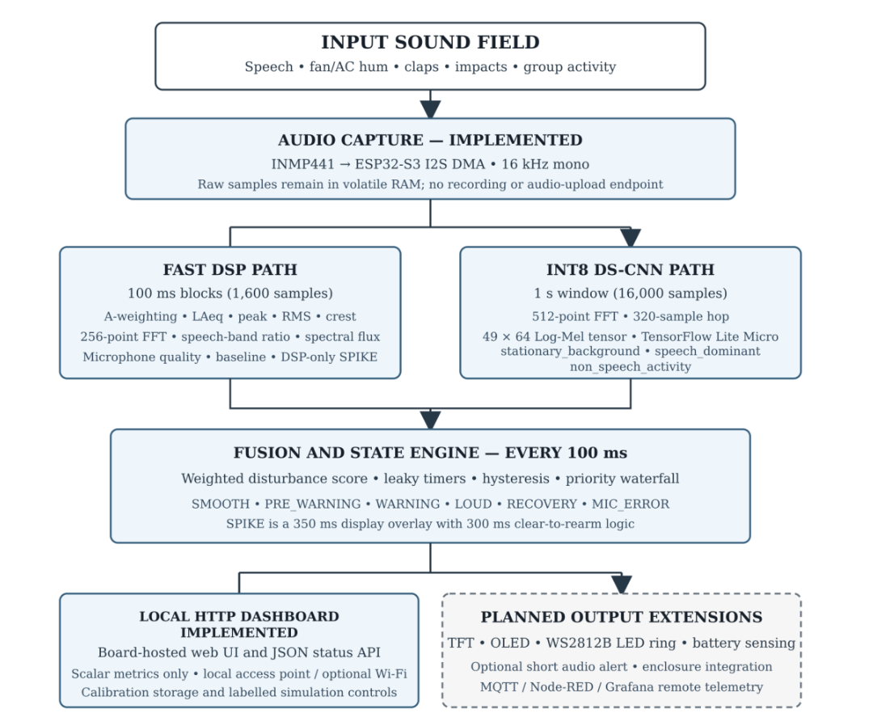
Methodology - [1] System Block Diagram
July 2026
9

Slide 10
Methodology - [2] Working Principle
Hybrid edge architecture: Splits acoustic analysis between deterministic DSP metrics and lower-frequency ML sound-context predictions.
Dual-core task separation: Core 1 runs I2S, DSP, and CNN processing; Core 0 manages Wi-Fi, networking, and the web dashboard.
Privacy-first ingestion: Processes short 25 ms DMA chunks in volatile memory and stores no raw-audio recordings.
Offline processing: Runs acoustic analysis, state transitions, and dashboard hosting locally with no cloud dependency.
Abstracted telemetry: Shares only anonymous, non-invertible scalar metrics on the local network.
July 2026
10

Slide 11
Methodology - [3] Operational Workflow
Signal preprocessing and filtering: Shifts 24-bit audio, applies gain, and removes DC offset using an IIR high-pass filter (alpha = 0.995).
Noise and artifact handling: Smooths energy across 100 ms blocks and applies cascaded SOS filters for A-weighted loudness.
Feature extraction: Uses a 256-point FFT, speech-band ratios (300-3,400 Hz), spectral flux, and a peak-envelope detector.
Hybrid decision-making: Combines inputs into a 0-100 Acoustic Disturbance Score and tracks escalation with leaky integrators and hysteresis.
State update and feedback: Drives the WS2812B LED ring and publishes a JSON payload to the local AJAX dashboard.
July 2026
11

Slide 12
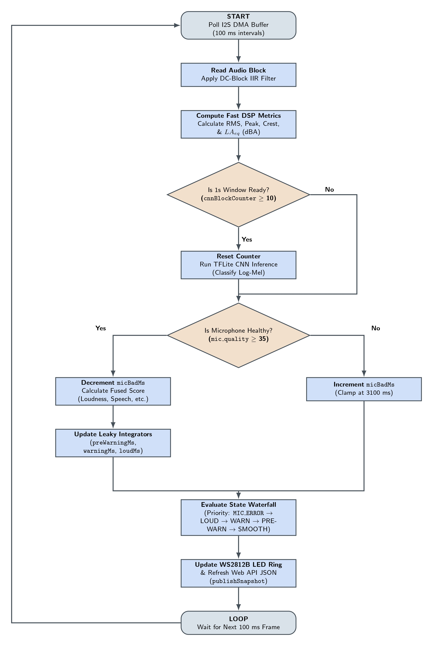
Methodology - [4] Proposed System Flow
July 2026
12

Slide 13
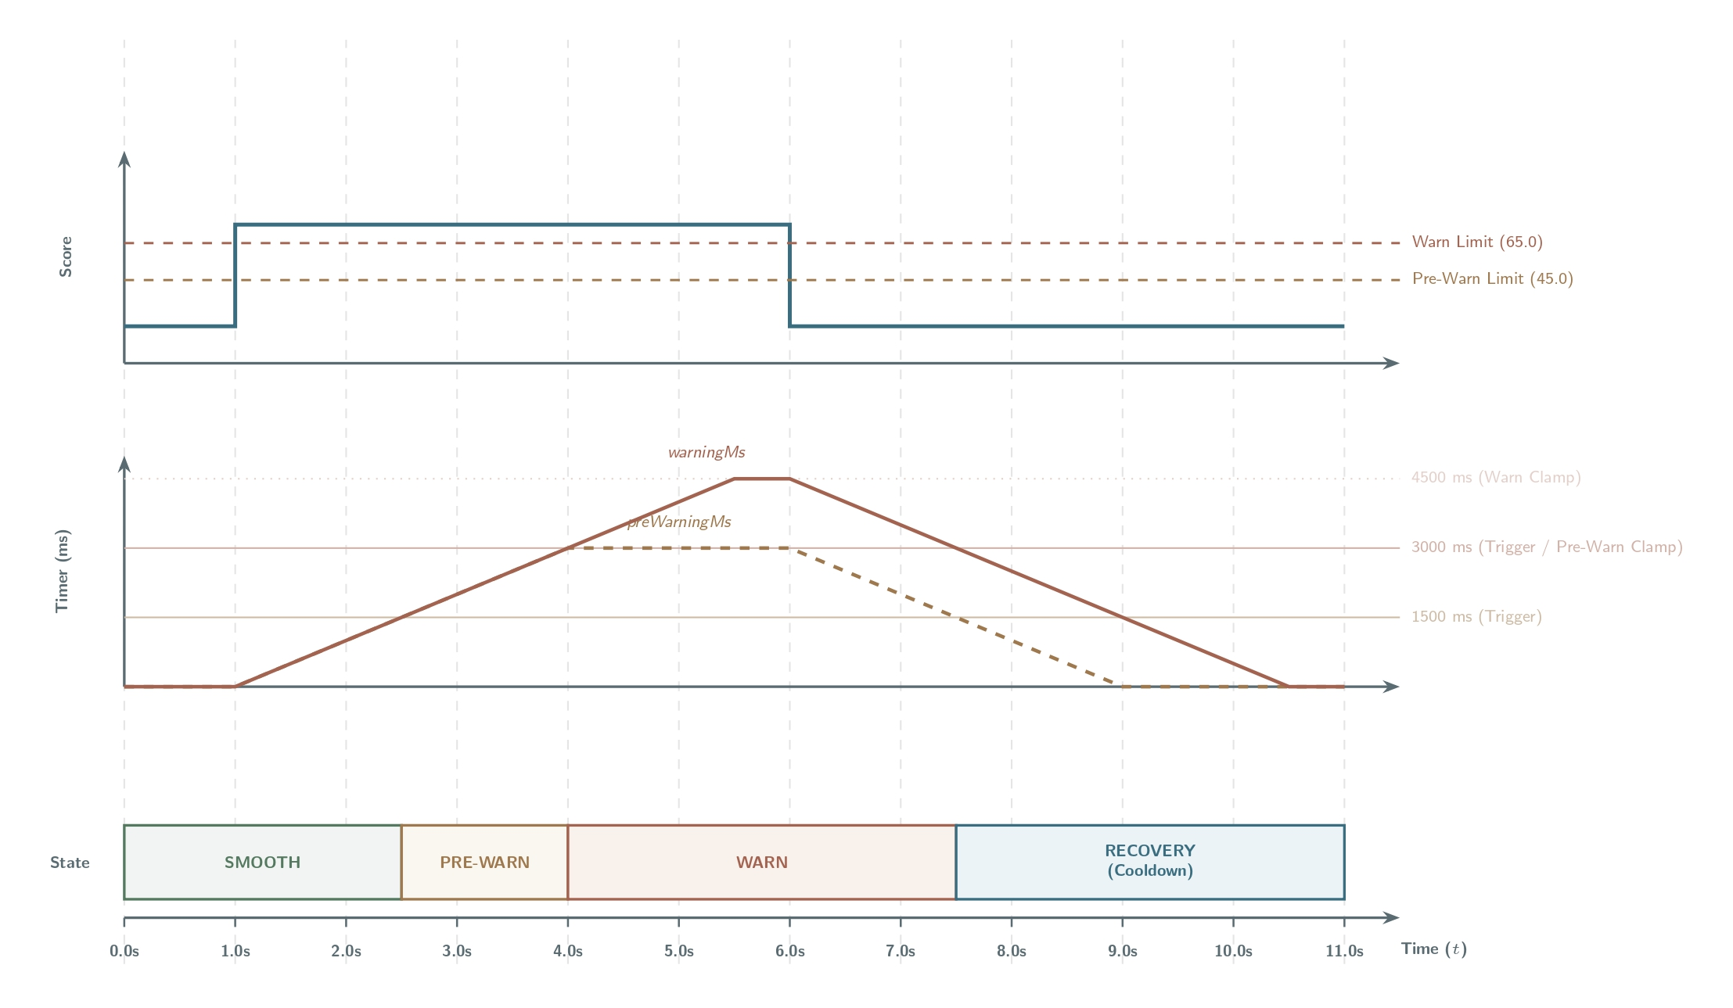
Methodology - [5] State-Machine Timing
Scenario 1: Standard score escalation and stepped decay
July 2026
13

Slide 14
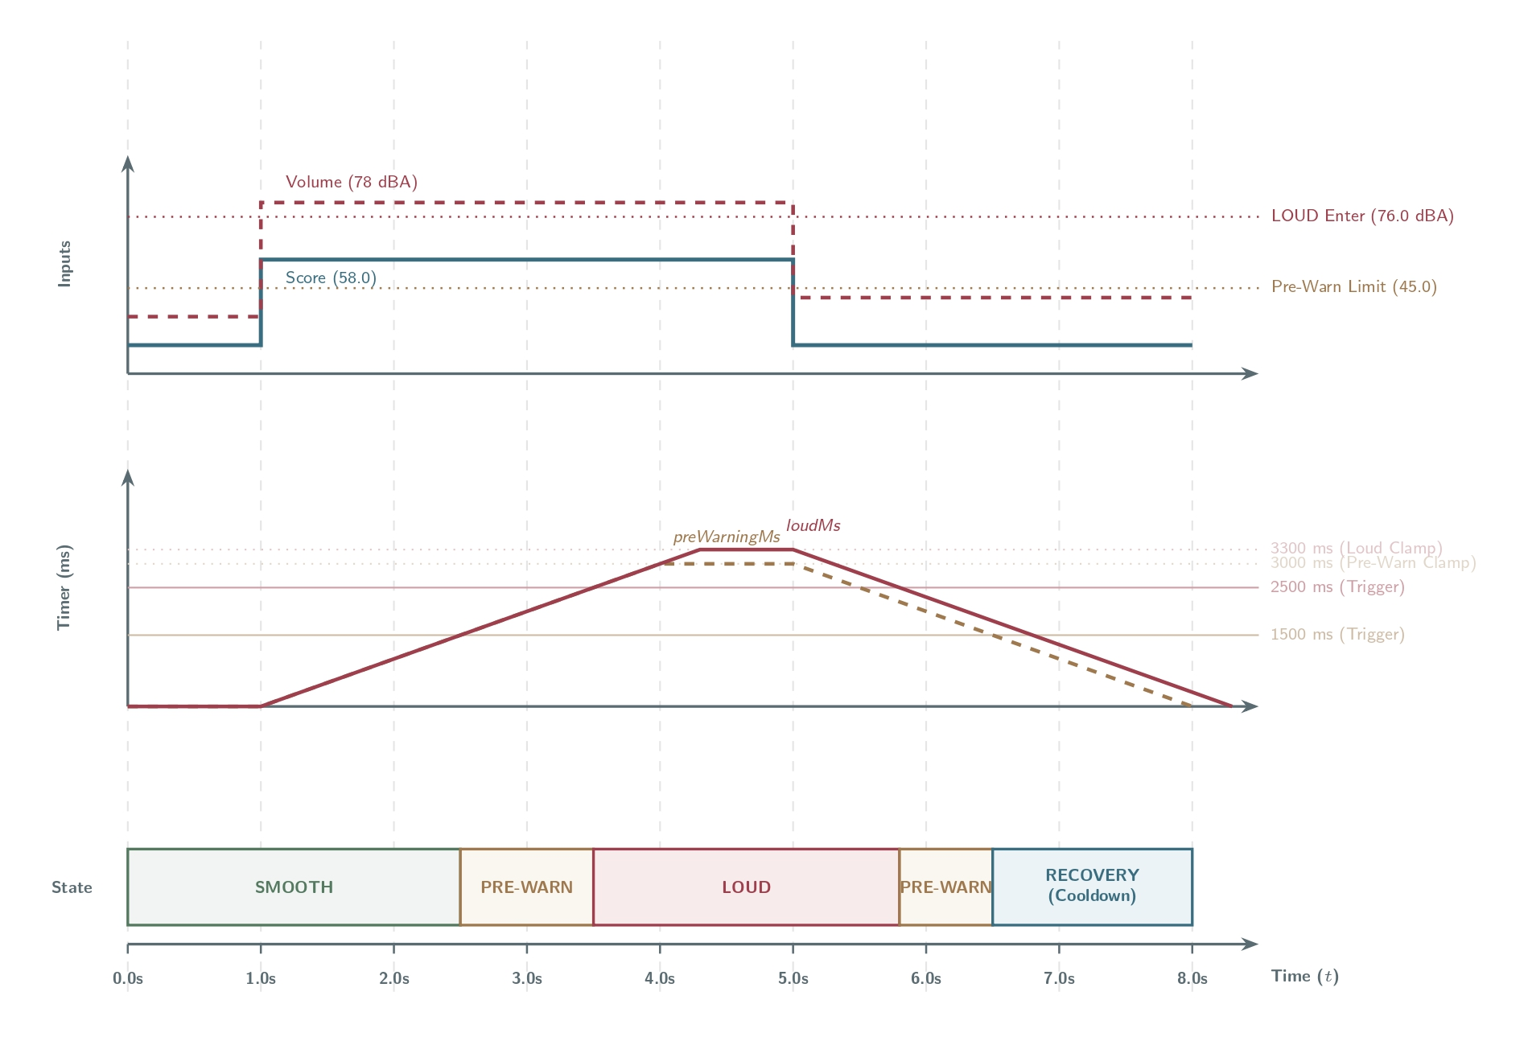
Methodology - [6] State-Machine Timing: Loud Operation
July 2026
14

Slide 15
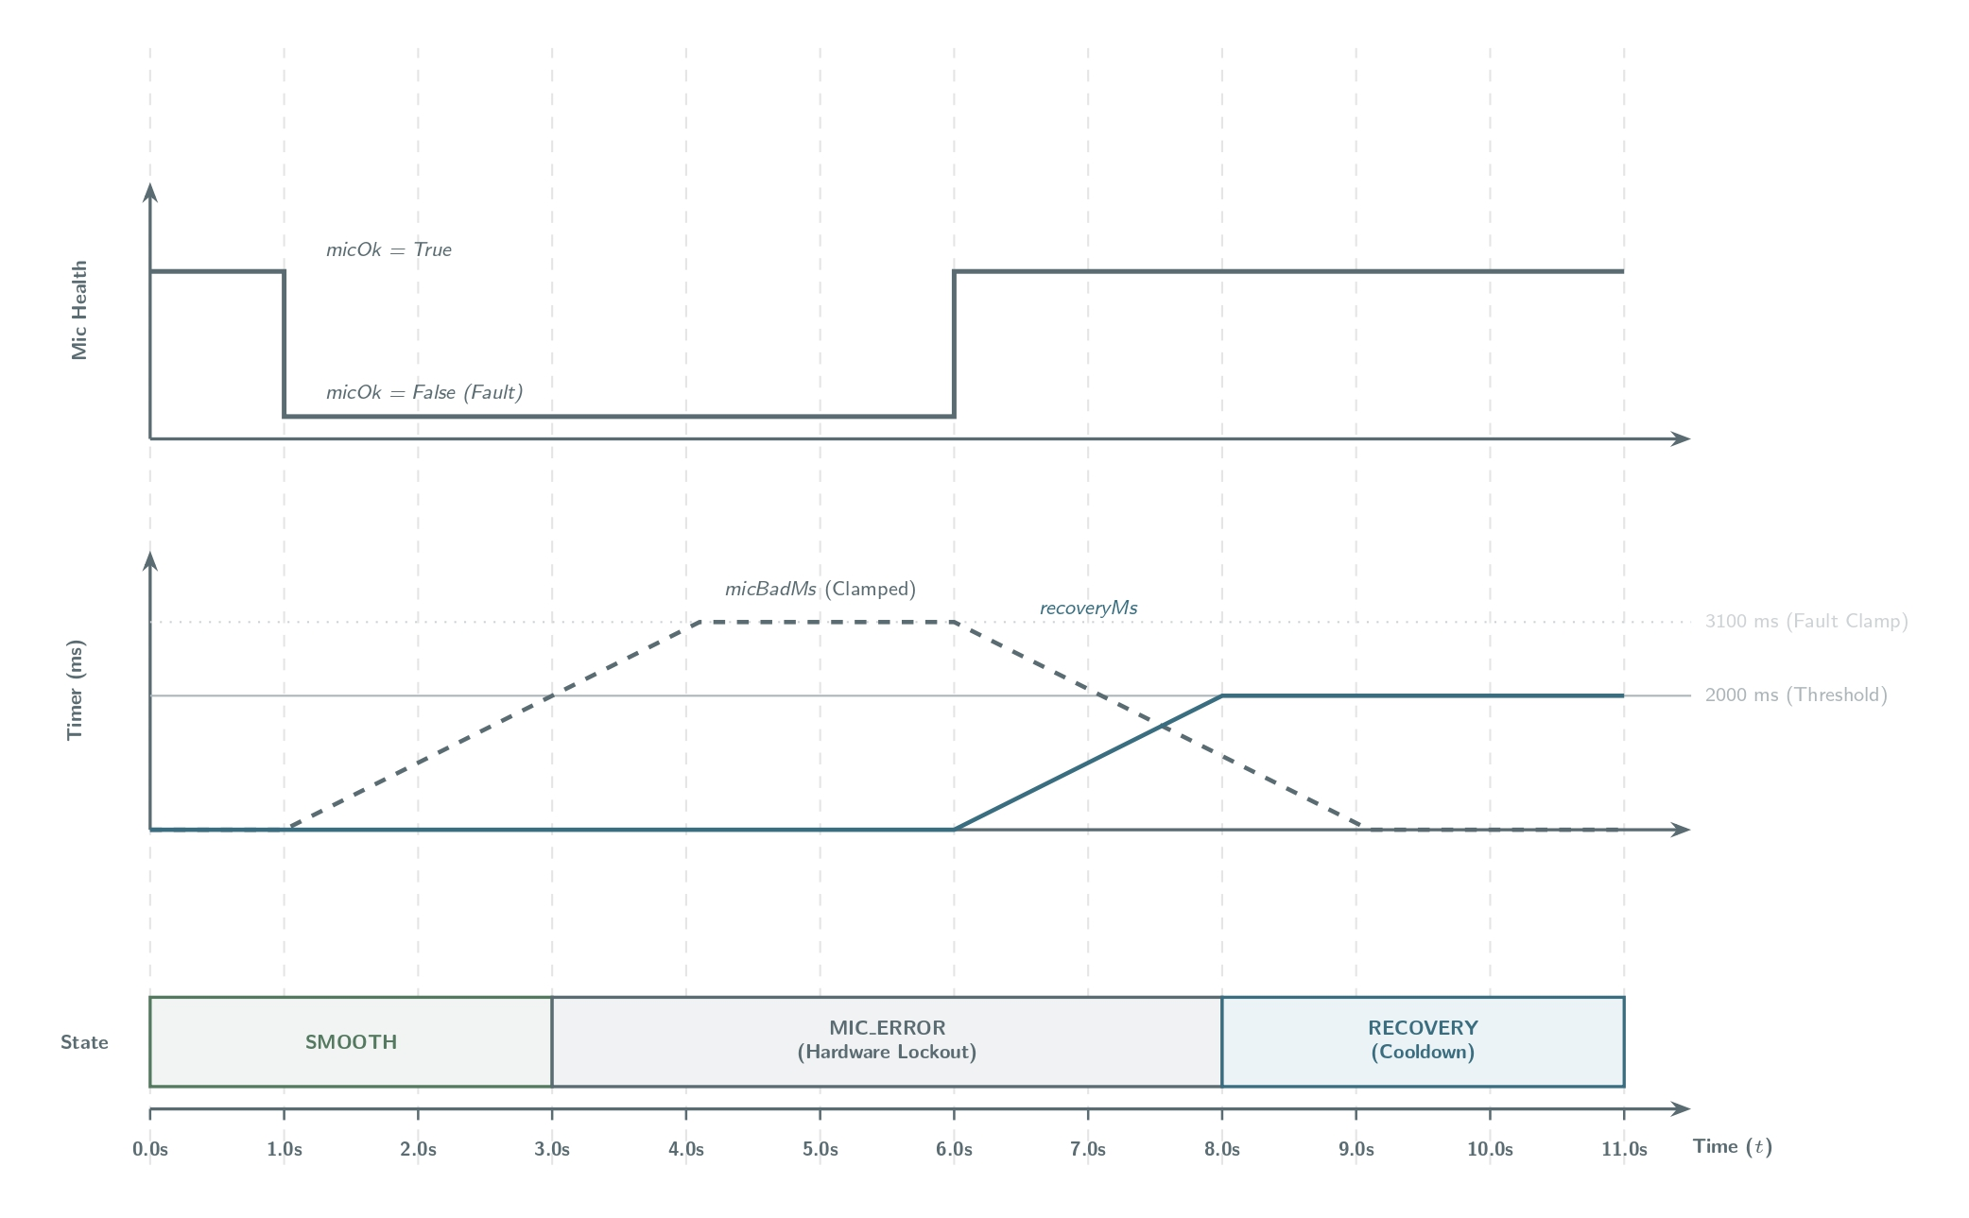
Methodology - [7] State-Machine Timing: Hardware Fault Lockout
July 2026
15

Slide 16
Methodology - [8] Hardware Requirements
ESP32-S3 microcontroller: Dual-core 240 MHz Xtensa LX7 with 8 MB flash and 8 MB PSRAM for real-time DSP and the INT8 model.
INMP441 microphone: Omnidirectional 24-bit I2S MEMS microphone with digital output.
WS2812B RGB LED ring: Sixteen individually addressable LEDs driven through the RMT peripheral for visual feedback.
3.7 V LiPo battery and BMS: 1,200 mAh battery with TP4056 charging and protection.
July 2026
16

Slide 17
Methodology - [9] Software Requirements
Arduino IDE: Firmware compilation, I2S driver configuration, FreeRTOS task setup, and serial debugging.
ESP-DSP: Optimized 256-point FFT and biquad SOS filtering on the ESP32-S3.
TensorFlow Lite for Microcontrollers: On-device execution of the fully quantized INT8 neural network.
Python, TensorFlow, and Librosa: Offline preprocessing, knowledge distillation, training, and quantization.
HTML5 Canvas and JavaScript: Local real-time AJAX dashboard over HTTP.
FreeRTOS: Deterministic task scheduling, synchronization, and dual-core workload management.
July 2026
17

Slide 18
Methodology - [10] CNN Model Training
Core artificial intelligence concepts implemented to train our AI model.
01
TRANSFER LEARNING
02
YAMNet as Teacher head
03
DS-CNN as Student
It means reusing a pre-trained model that has already learned from a large dataset.
We adapt it to classify environmental sounds for our system and use Knowledge Distillation to train a lightweight model.
YAMNet is a powerful pre-trained audio classifier (MobileNetV1 based) developed by Google.
Used to extract 1,024-D embeddings from raw audio.
It also predicts the most likely sound class with a confidence score.
it is fast, lightweight, and requires much less computation and memory than a standard CNN, making it suitable for microcontrollers.
Uses depthwise separable convolution operations.
Teacher–Student Architecture (Knowledge Distillation)
YAMNet is too large for microcontrollers, Knowledge Distillation trains a compact 'Student' model to match the soft probability outputs of the heavy 'Teacher' model.
This compresses deep learning intelligence so it can run directly on the ESP32-S3.

Slide 19
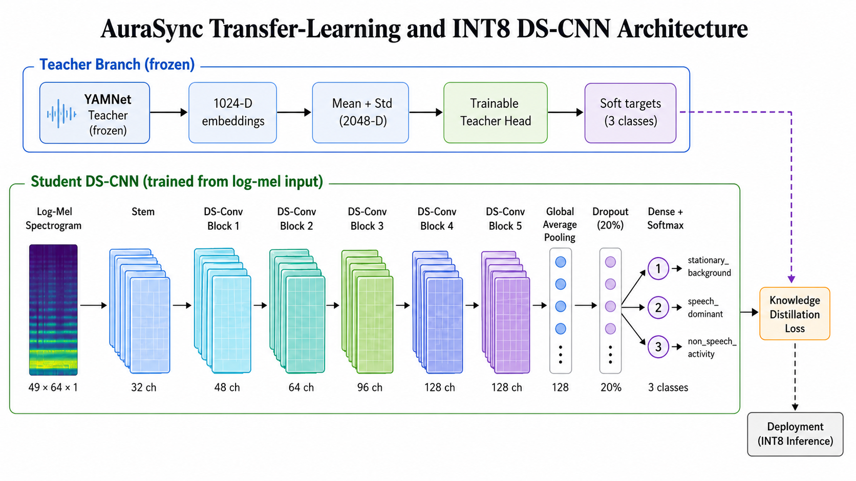
Methodology - [11] Teacher-Student DS-CNN Architecture
Multiple student configurations were evaluated during training, and the model with the lowest Knowledge Distillation loss was deployed on the ESP32-S3.
July 2026
18

Slide 20
Methodology - [12] Dataset Overview
Dataset Preparation:
Collected 12,466 environmental audio clips
Each clip is 1 second long, sampled at 16 kHz
Three audio classes:
Stationary Background
(fan, AC, computer hum, quiet room)
Speech Dominant (conversations, discussions, lectures)
Non-Speech Activity (typing, footsteps, chair movement, coughing, clapping)
Dataset Split:
July 2026
19

Slide 21
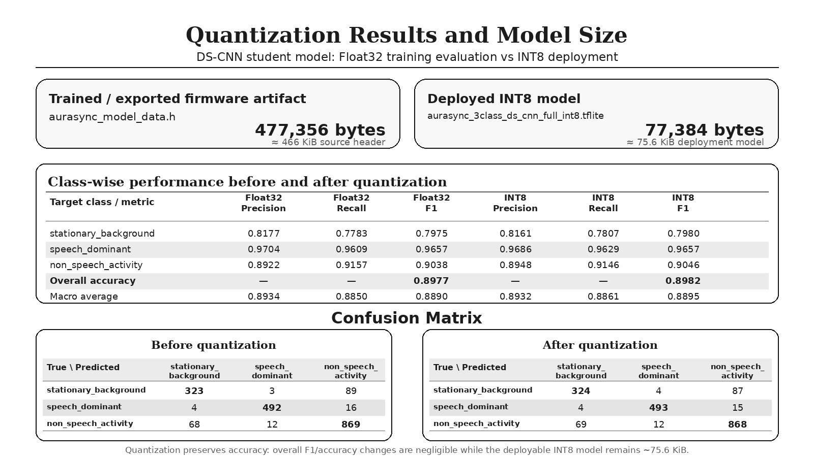
Results - [1] Model Performance
Quantization reduced the model from 466 KiB to 75.6 KiB while preserving accuracy (89.77% to 89.82%).
July 2026
21

Slide 22
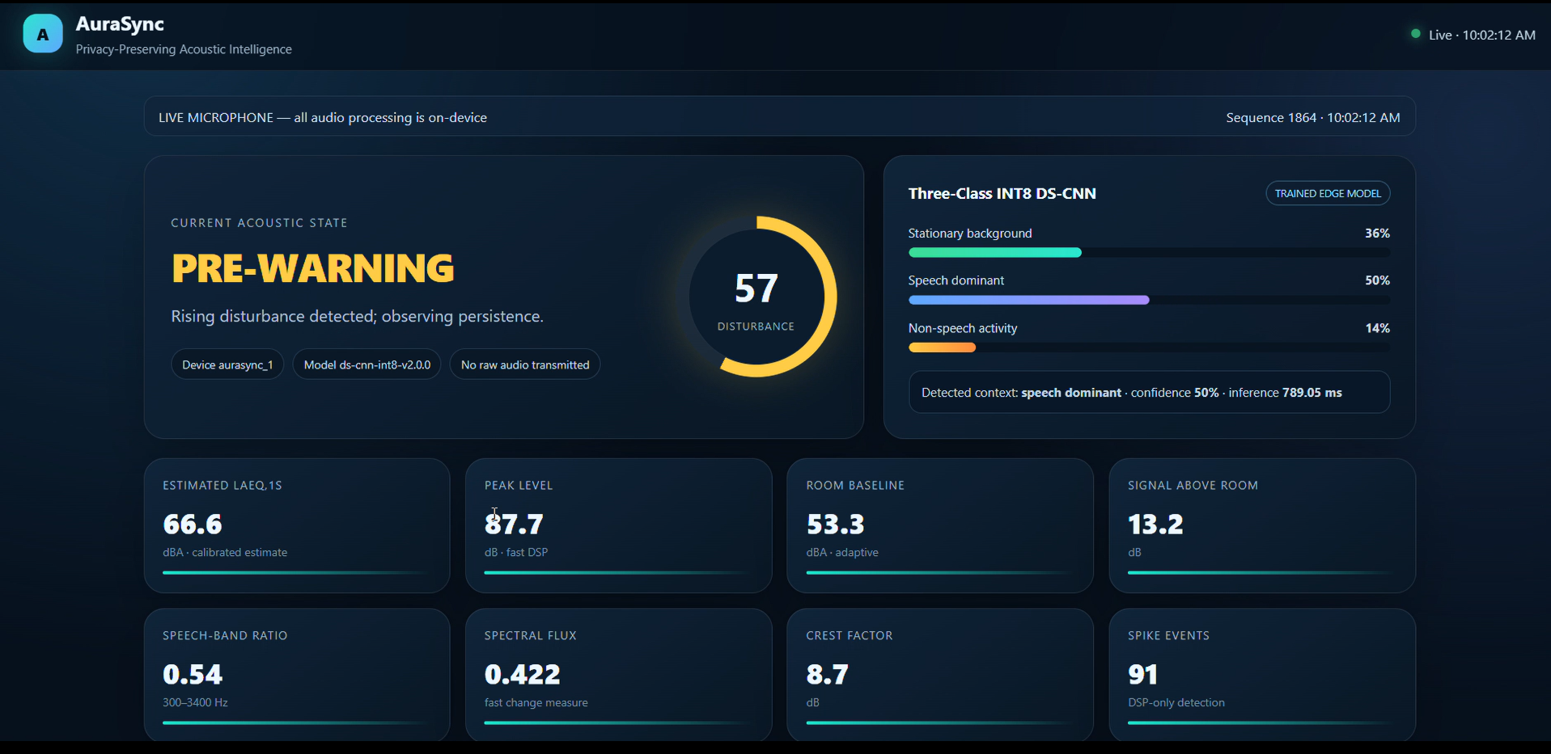
Results - [2] Web Dashboard
July 2026
22

Slide 23
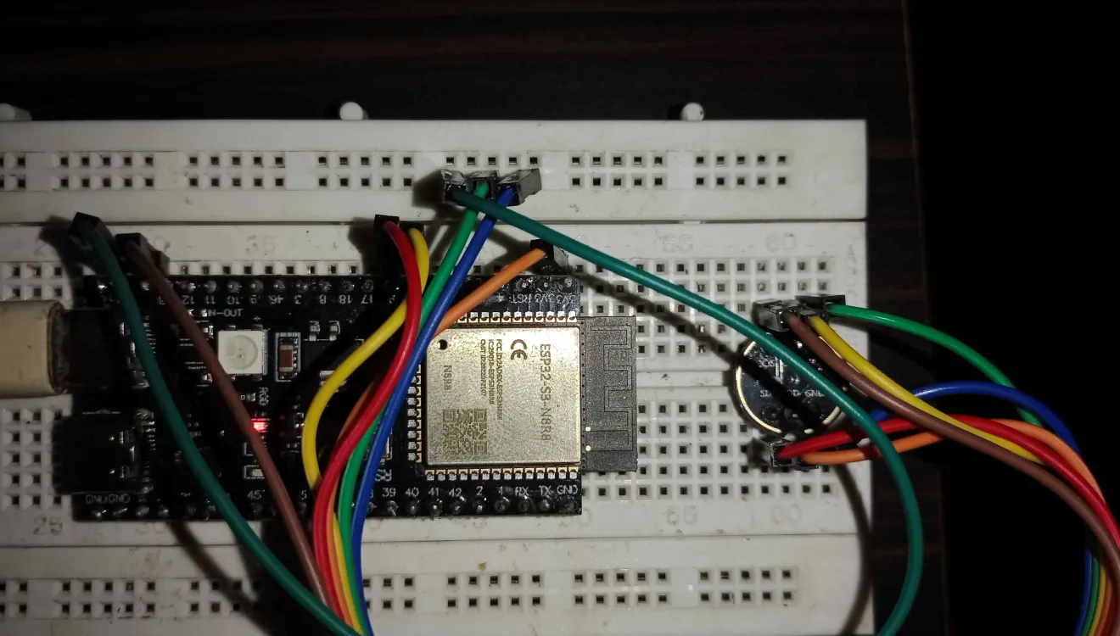
Results - [3] Prototype
July 2026
23

Slide 24
Results - [4] Validation Data
Scenario ID | LAeq (dBA) | Peak (dB) | Baseline (dBA) | Crest (dB) | Speech Ratio | Score (0-100) | Model Prediction | FSM State
VAL-01 Conversation | 62.4 | 72.8 | 48.2 | 10.4 | 0.68 | 68 | speech dominant | WARNING
VAL-02 Quiet baseline | 43.1 | 49.8 | 43.1 | 6.7 | 0.22 | 4 | stationary background | SMOOTH
VAL-03 Fan | 53.8 | 59.8 | 53.5 | 6.0 | 0.12 | 10 | stationary background | SMOOTH
VAL-04 Handclap / spike | 55.2 | 82.4 | 45.0 | 27.2 | 0.35 | 22 | non-speech activity | SPIKE
VAL-05 Speech stops | 46.2 | 52.8 | 45.0 | 6.6 | 0.25 | 10 | stationary background | RECOVERY
July 2026
24

Slide 25
Analysis
The INT8 model retains nearly the same accuracy as Float32 (89.82% vs. 89.77%), indicating negligible quantization impact.
Speech-dominant is the strongest class (F1 ≈ 97%); stationary background is most often confused with non-speech activity.
DSP features and priority-waterfall FSM logic compensate for borderline CNN decisions.
Temporal hysteresis and leaky integrators prevent state flicker during short confidence fluctuations.
Mic Quality, Zero%, and Clip% telemetry distinguishes genuine silence from hardware faults and supports MIC_ERROR handling.
Overall, hybrid DSP-CNN fusion is more robust than either path alone.
July 2026
25

Slide 26
Future Enhancements
Custom PCB and improved acoustic and enclosure design
IP-rated housing and selectable noise-policy modes
Secure MQTTS and multi-device dashboards
Over-the-air firmware updates
Larger device-specific training datasets
Privacy-preserving adaptive room-baseline calibration
July 2026
26

Slide 27
Conclusion
Successful edge implementation: A fully local, privacy-preserving ESP32-S3 TinyML system estimates acoustic comfort in real time without raw-audio retention or cloud dependence.
Efficient quantization: The 75.6 KiB, 46,867-parameter INT8 DS-CNN retains 89.82% test accuracy for on-device inference.
Robust hybrid fusion: Deterministic DSP metrics and probabilistic ML predictions complement each other beyond a single-path design.
Temporal stability and safety: Leaky-integrator hysteresis reduces state flicker, while MIC_ERROR diagnostics protect against hardware faults.
July 2026
27

Slide 28
References
[1] ISO 22955:2021.
[2] ANSI/ASA S12.60:2010.
[3] Ellermeier and Zimmer, JASA, 1997.
[4] Haka et al., Indoor Air, 2009.
[5] Warden and Situnayake, TinyML, 2019.
[6] Hershey et al., ICASSP, 2017.
July 2026
28

